Slide 1
super and this keywords in java?
momedaram

Slide 2
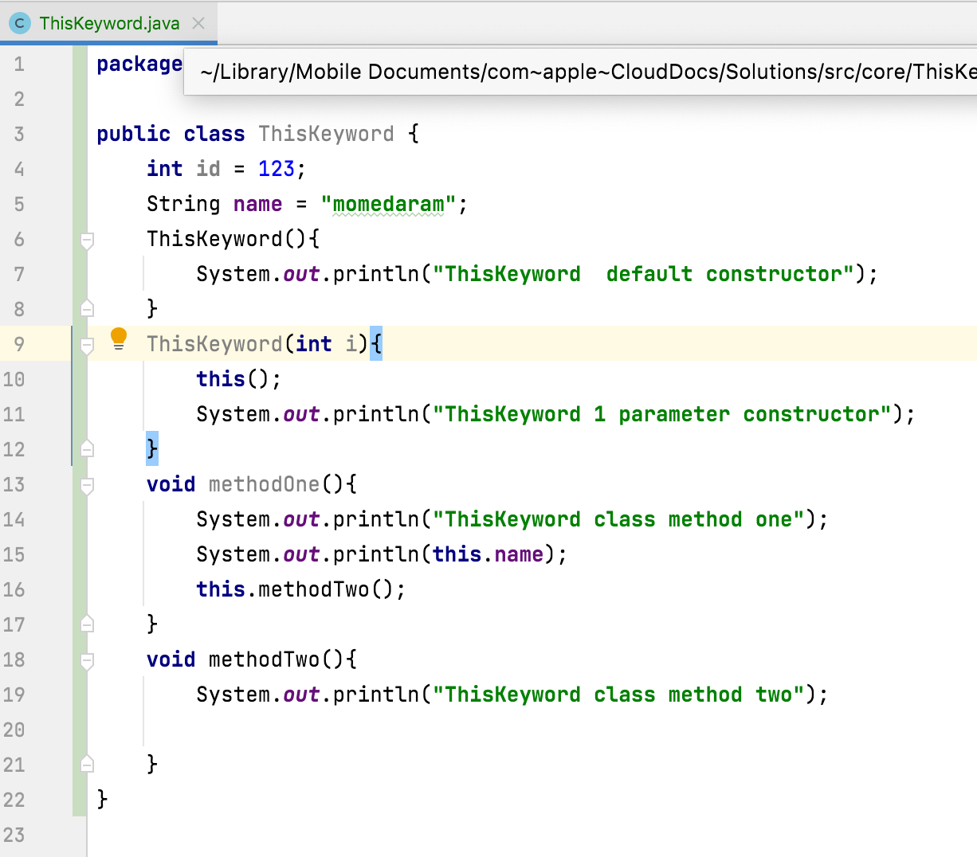
this keyword
Is used to access other members of the same class.
By Using this keyword, you can access methods, fields and constructors of the same class within the class

Slide 3
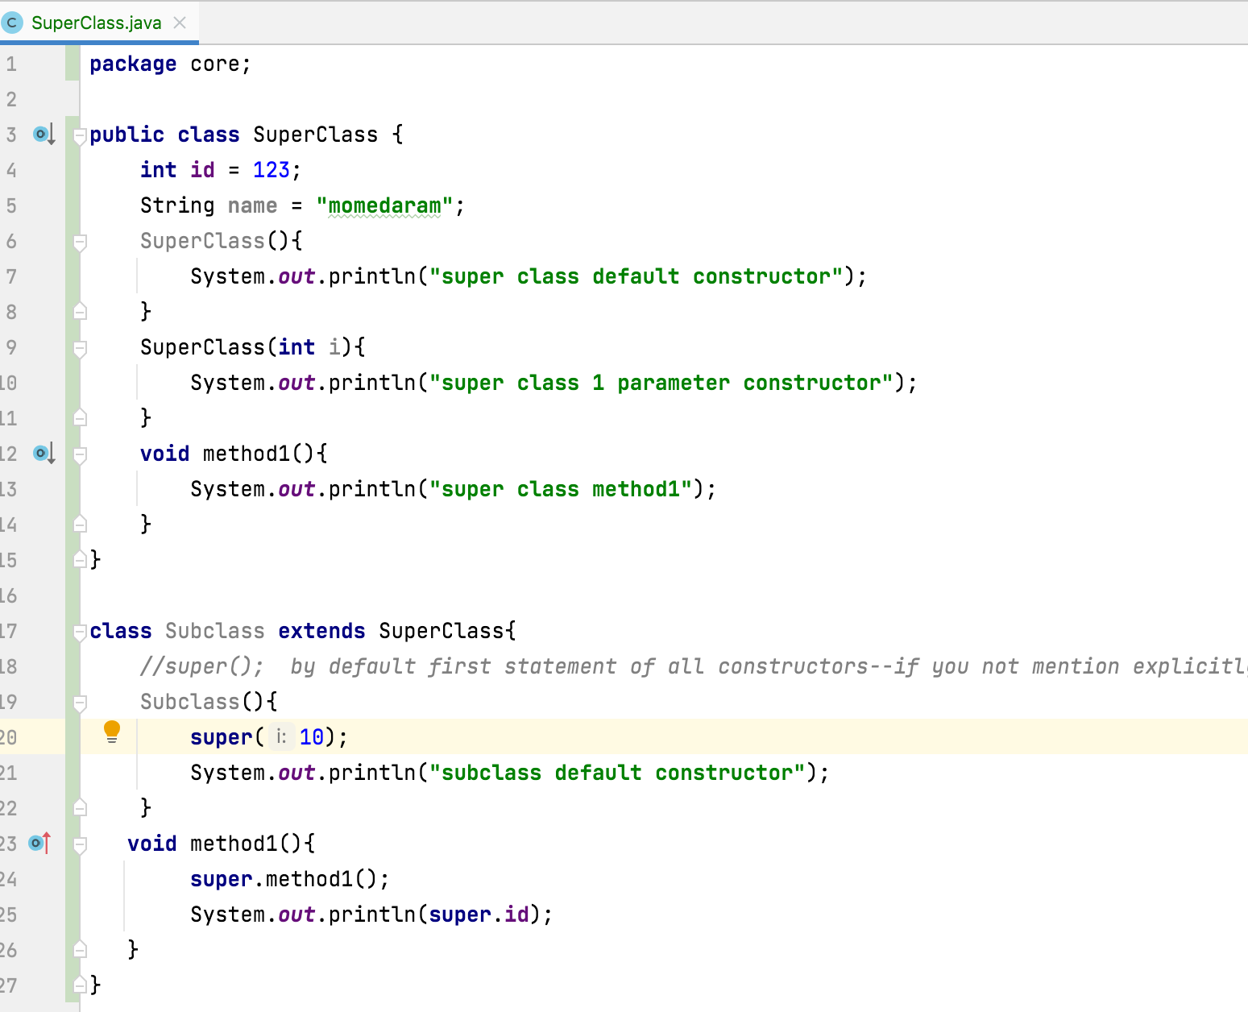
Super keyword
Is used to access super class members inside the sub class.
By using super keyword, we can access super class methods, super class fields and super class constructors in the sub classes.

Slide 4
Note:
You can’t use super and this keywords in a static method and in a static initialization block
You should call super() and this() calling statements inside the constructors only and they must be first statement in the constructors.
First statement of constructors eighter this() or super(), not both.

Slide 5
Thank You!
momedaram

